Slide 1
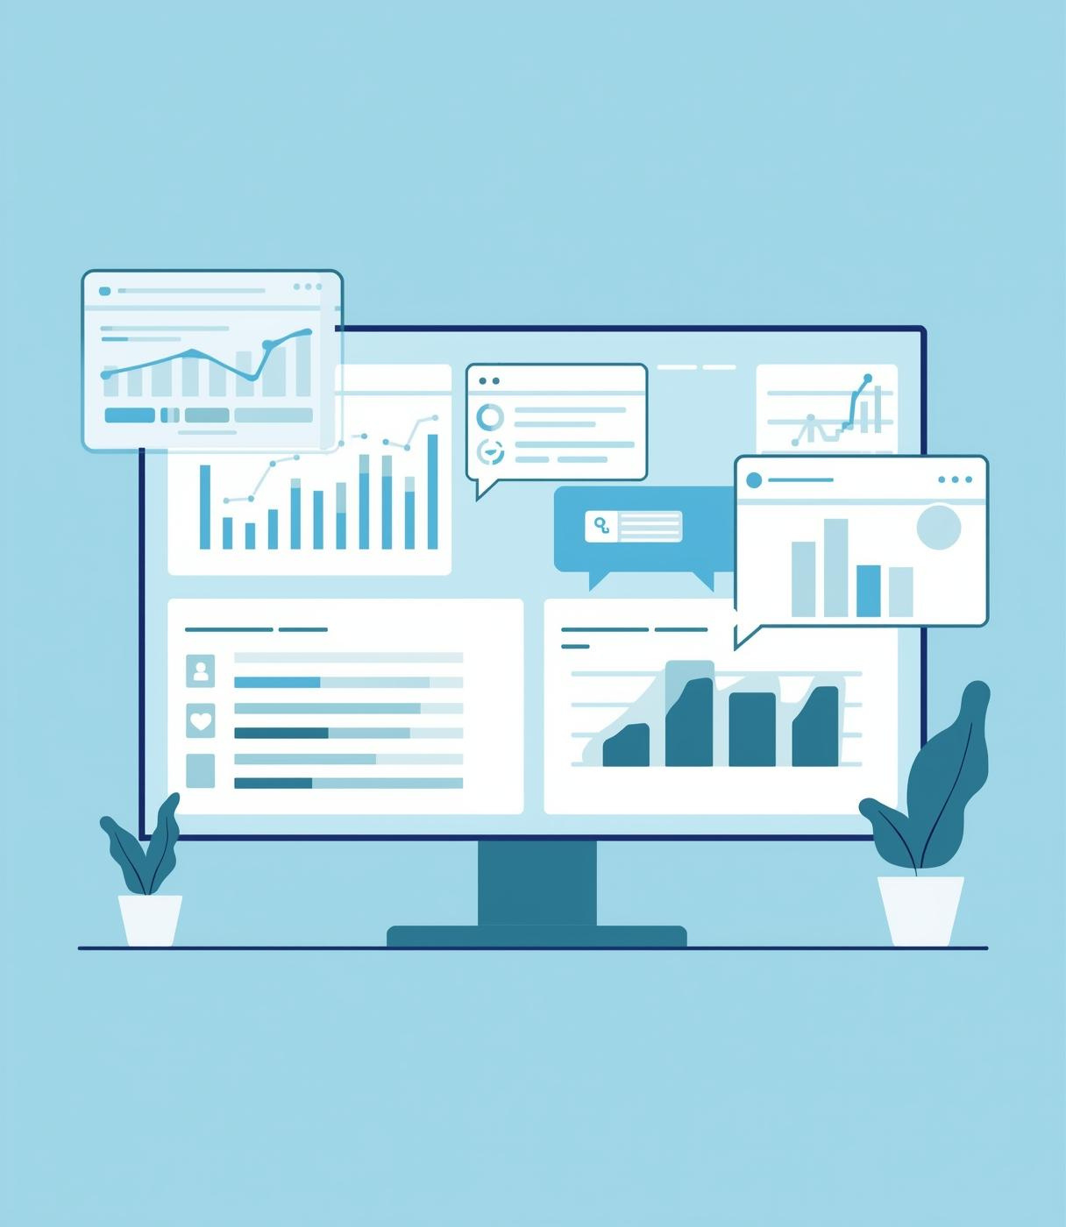
BABSON COLLEGE
Panel Project
Interactive Dashboard
Cherprang Reanchaiyuth, OIM 7502

Slide 2
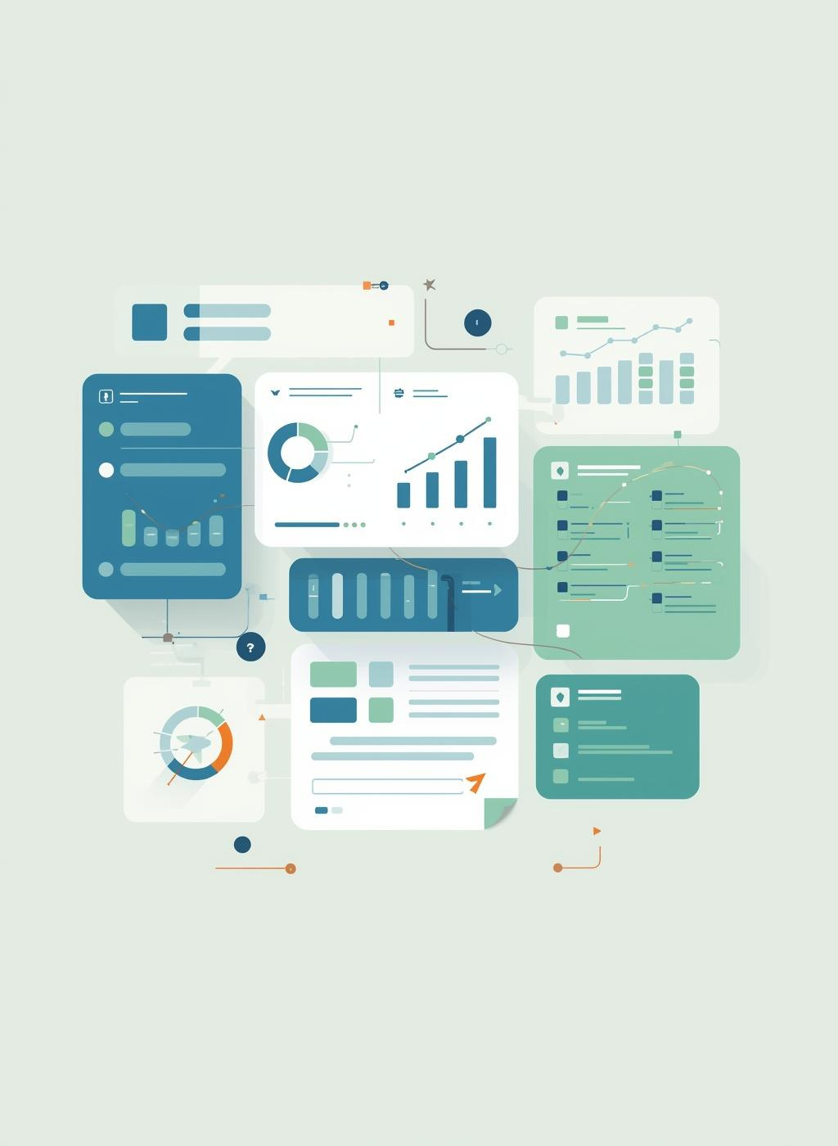
Understanding
the Panel
Interactive Dashboard Library
Panel is a powerful Python library designed for building interactive dashboards and applications, enabling seamless combination of widgets with data visualization, enhancing user engagement in data exploration.

Slide 3


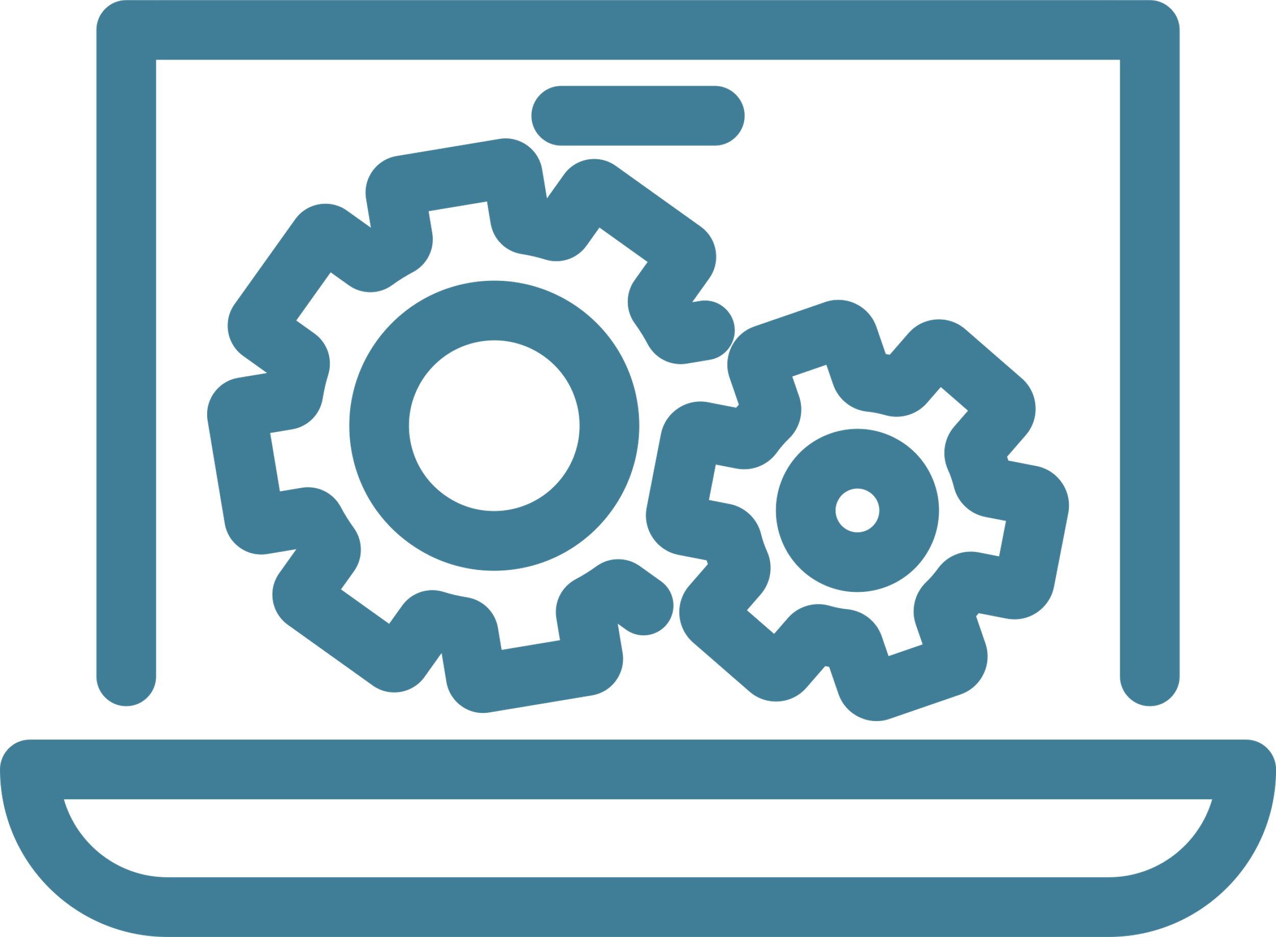
Objectives of Panel
SIMPLIFY DATA EXPLORATION
CONNECT DATA AND VISUALS
RAPID DASHBOARD DEVELOPMENT
Enables intuitive interactivity, helping users explore data and uncover insights through easy-to-use controls and visuals.
Seamlessly connects data, visuals, and controls to create a unified, interactive dashboard experience.
Enables quick creation of interactive dashboards, reducing development time while delivering high-quality visuals.

Slide 4
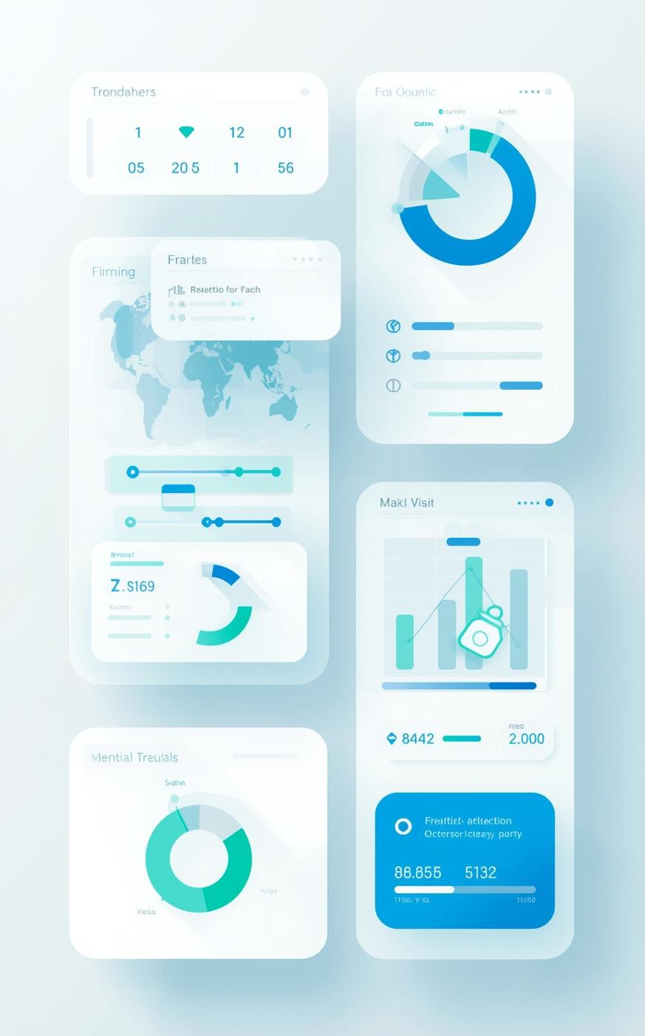
My Dashboard Overview
Exploring Wage Insights with Panel
  Utilizes the Wage.csv dataset to analyze how education, job class, and age impact wages.
  Interactive filters allow users to explore metrics like average and median wage.
  Visuals update automatically for a smooth data exploration experience.

